Slide 1
IoT Using LoRaWAN
CSE3PRB - Team F

Slide 2

Team
Michael Owczarek
Joel Morran
Remi Petit
James Curnow
Luis Shigetomi
Notes:
All

Slide 3

Agenda / Purpose
System Overview
Constraints
High-Level System Architecture
Tech Stack
Structural View
User Stories
Agile
Testing
Implementation
Issues & Improvements
Project Conclusion / Final Thoughts
Notes:
Michael

Slide 4
System Overview
A network capable of receiving and storing sensor data in a database on the cloud. Using the stored data the system can display a range of different views and graphical representations in a meaningful way to users through the use of Power BI software.
Benefits of the system
Data is received in real time
GPS tracking
Graphical data representation
Data can be filtered by time
Capable of generating reports with data
Notes:
James

Slide 5

Constraints
Azure cost
IoT 40000 message limit
Sensor / Gateway Range
GPS signal
Notes:
Joel

Slide 6
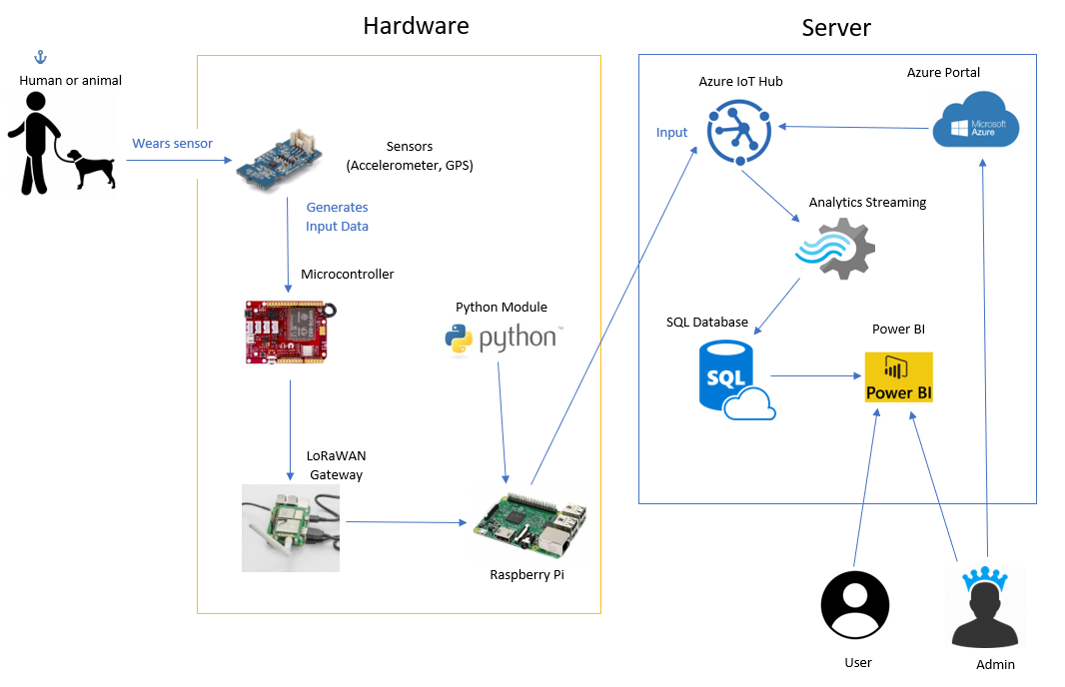
Old High-Level System Architecture
Notes:
James

Slide 7
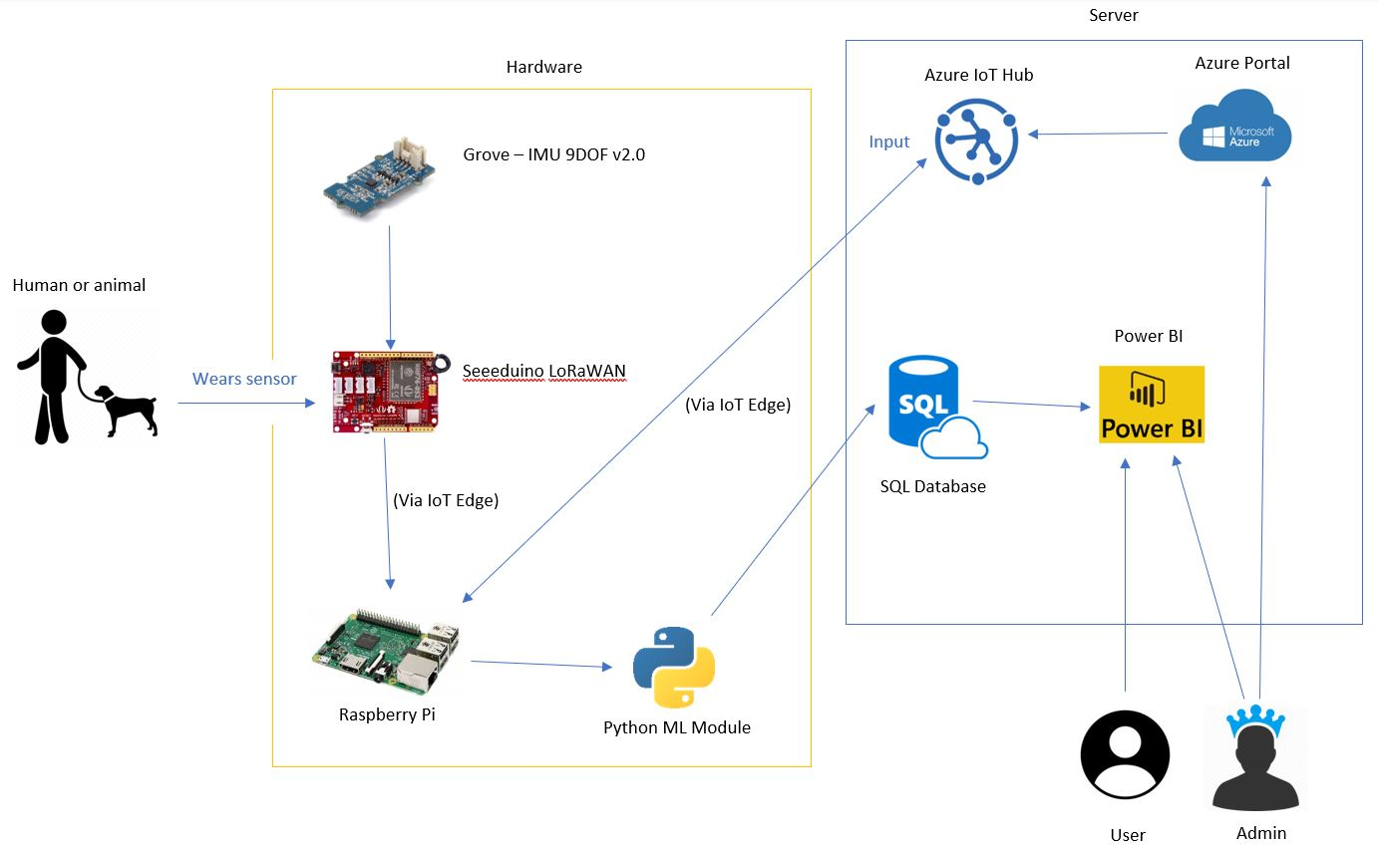
Updated High-Level System Architecture
Notes:
James

Slide 8
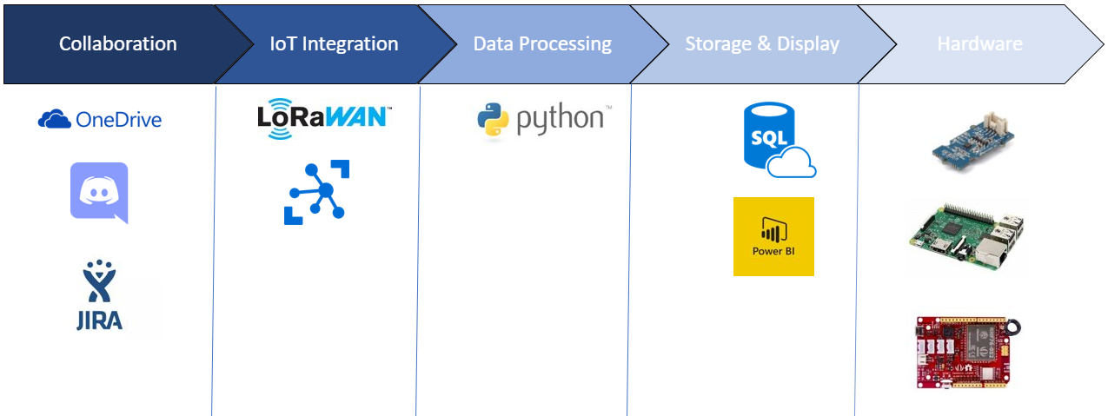
Tech Stack
Notes:
James

Slide 9
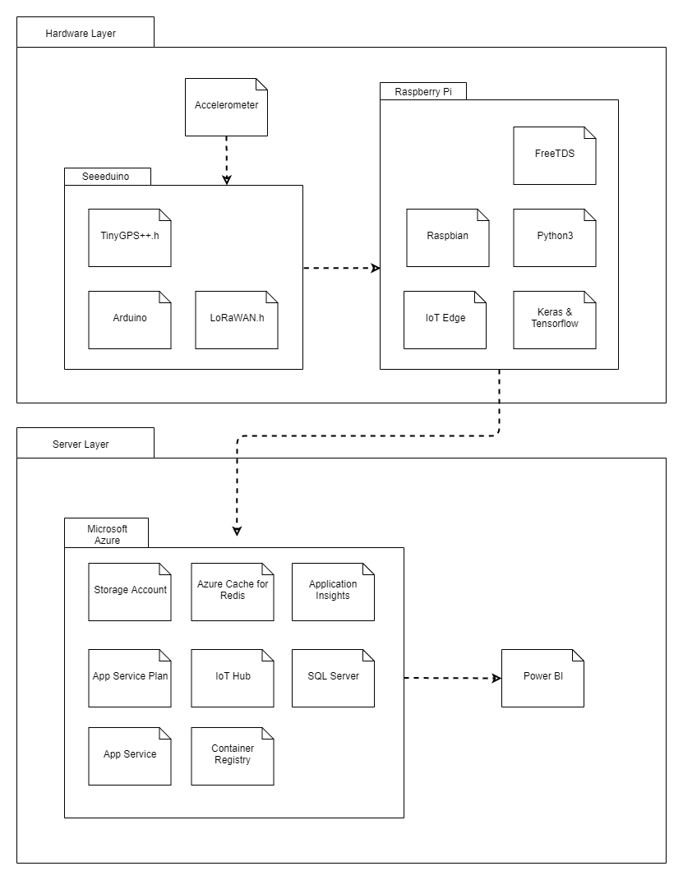
Structural View- UML
Notes:
James

Slide 10

Agile – Original User Stories
As a User I want…
Clean UI / Easy to understand
Easy setup (hardware & software)
Cost effective
Data easy to export
Notes:
Luis

Slide 11
Agile - Updated User Stories
As a User I want to…
View a pie chart of the subject’s behaviour
View a map showing features
View a table of all collected data
Filter data by a chosen date range
Notes:
Luis

Slide 12
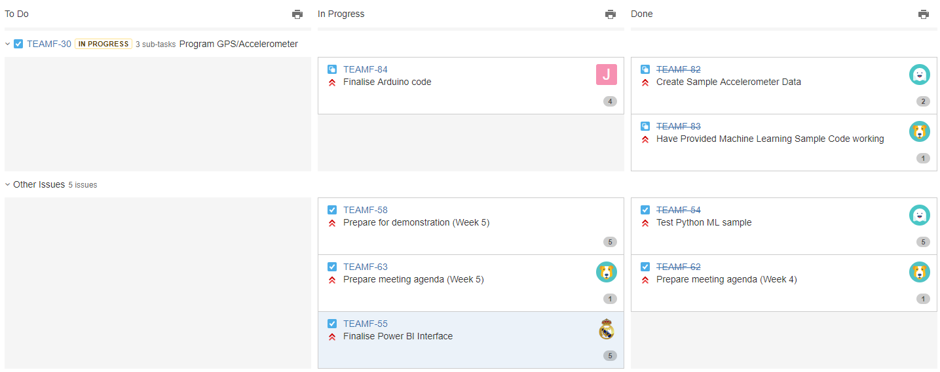
Agile – Task Allocation Example
Notes:
Joel

Slide 13
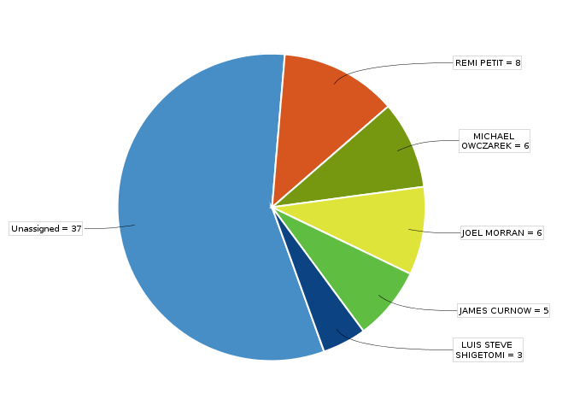
Agile – Task Allocation Pie Chart
Notes:
Joel

Slide 14
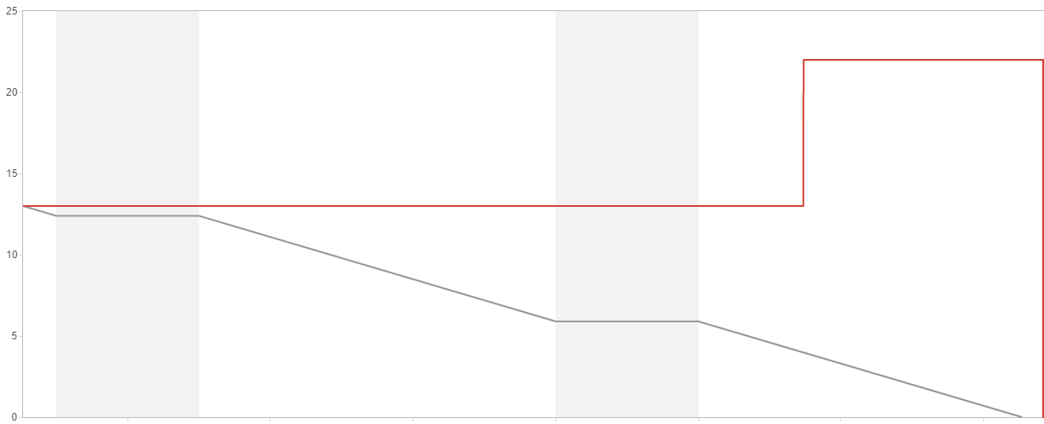
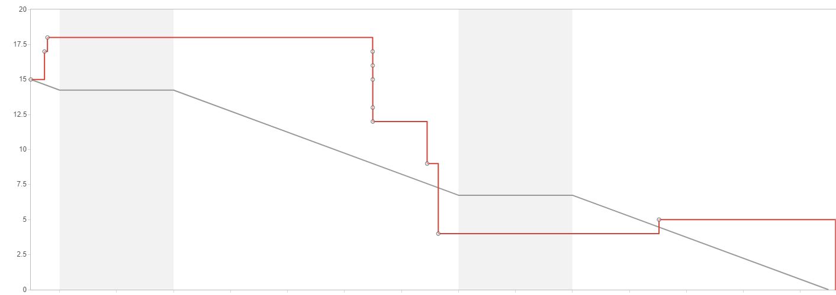
Agile – Burndown Improvements
Early Sprint
Later Sprint
Notes:
Luis

Slide 15
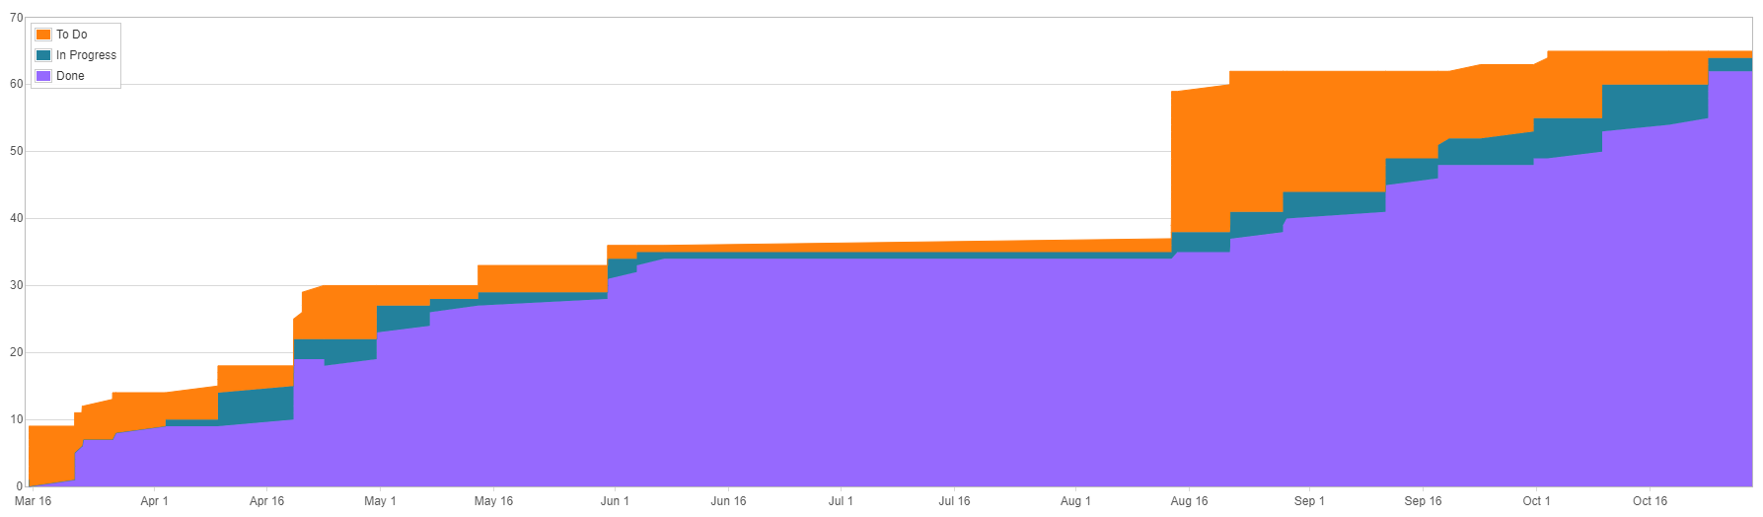
Agile – Cumulative Flow Diagram
Notes:
Luis

Slide 16
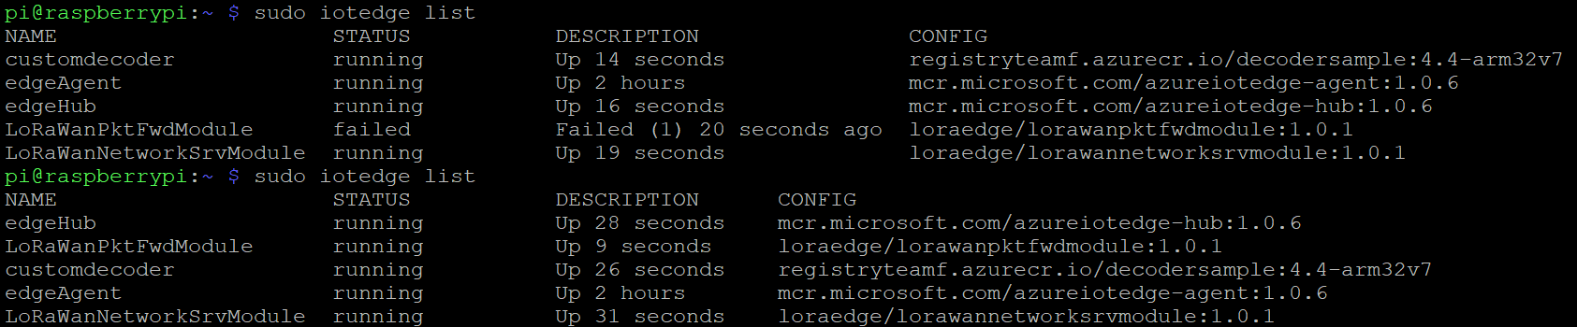
Testing - Unit Testing
Notes:
Joel

Slide 17
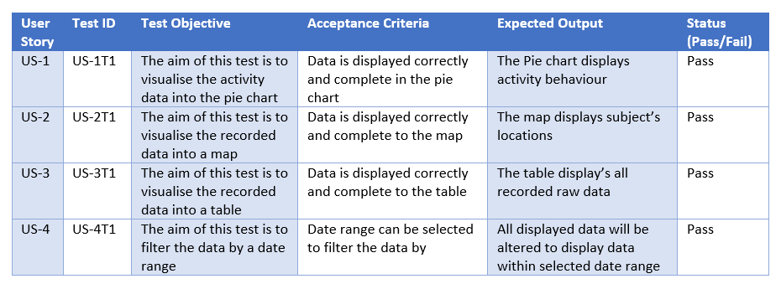
Testing - User Story Testing
Notes:
Joel

Slide 18
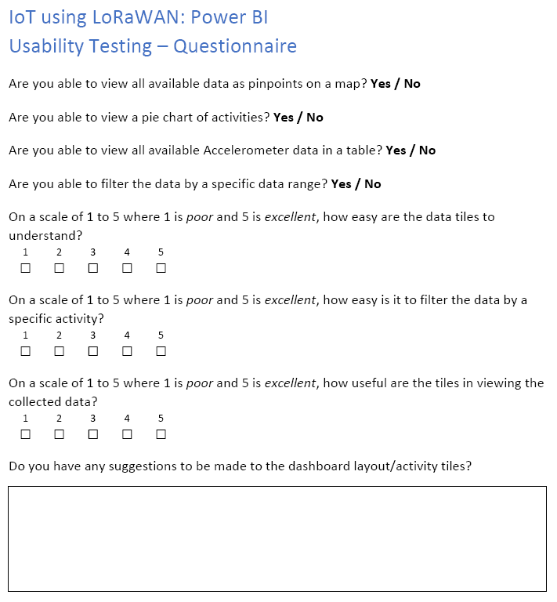
Testing - Usability Testing
Common Issues:
Map hard to read
Info hard to find/see
Tiles too small
Notes:
Joel

Slide 19
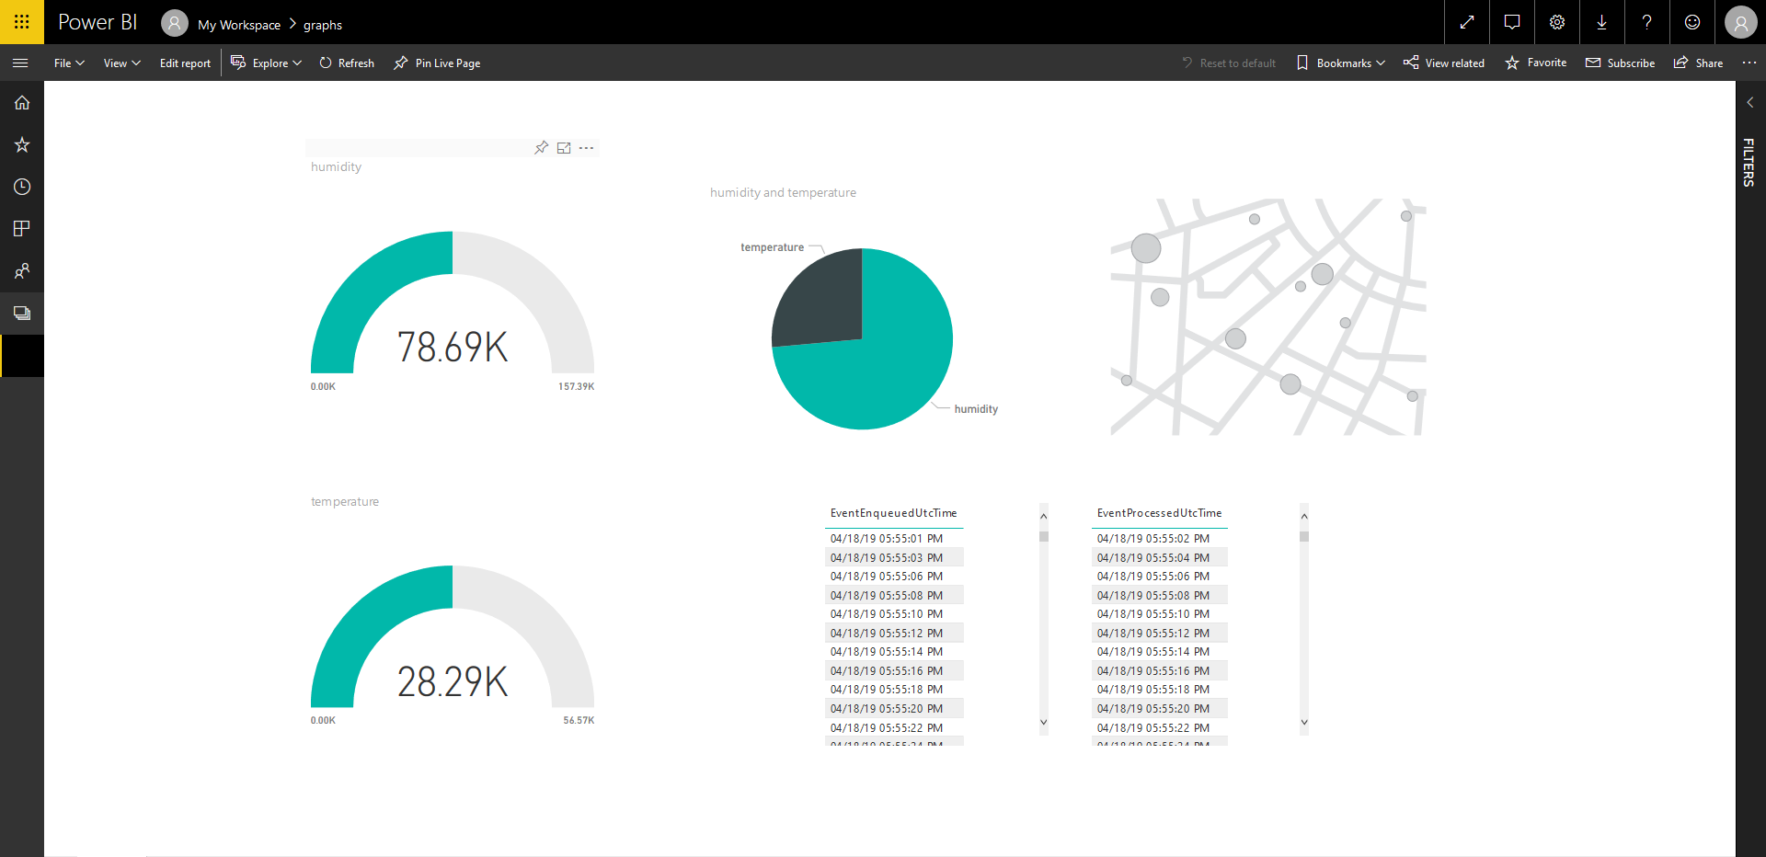
Previous Power BI Interface
Notes:
Joel

Slide 20
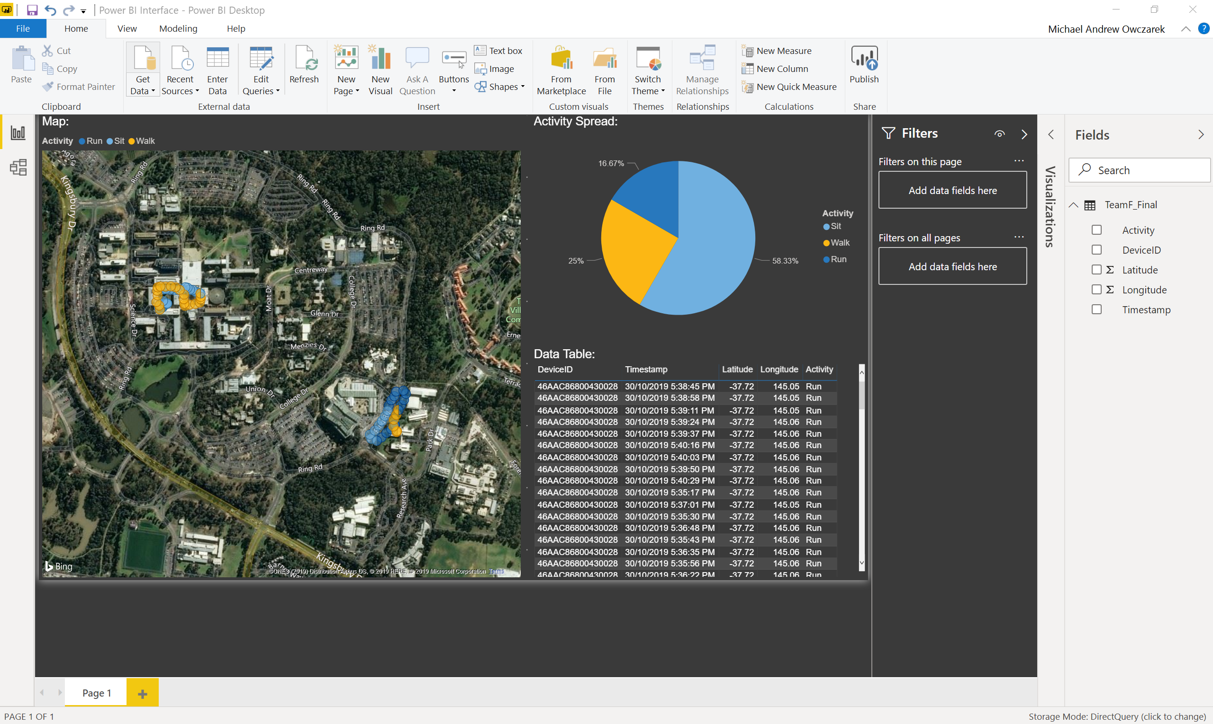
Final Power BI Interface
Notes:
Joel

Slide 21
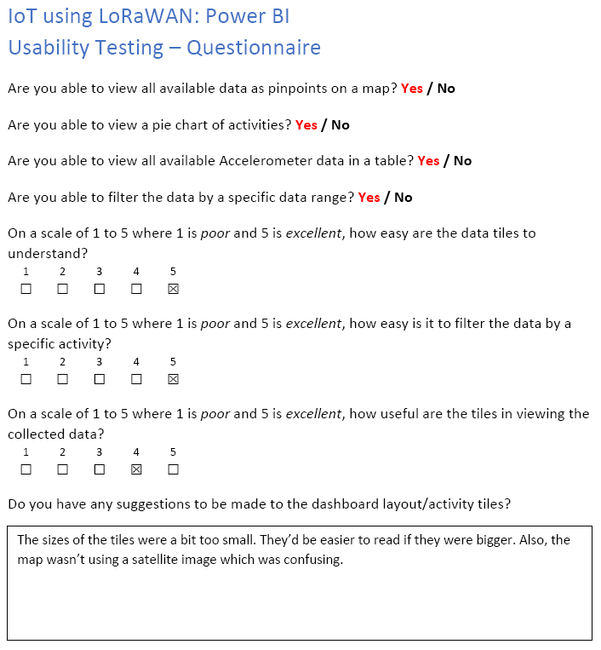
Testing - Usability Testing Example
Notes:
Joel

Slide 22

Implementation
Data Collection
Machine Learning
Database
Power BI
Notes:
Michael & Remi

Slide 23
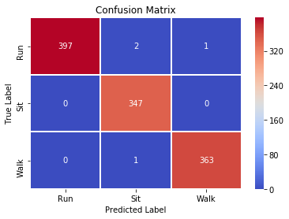
Implementation - ML
Notes:
Remi

Slide 24
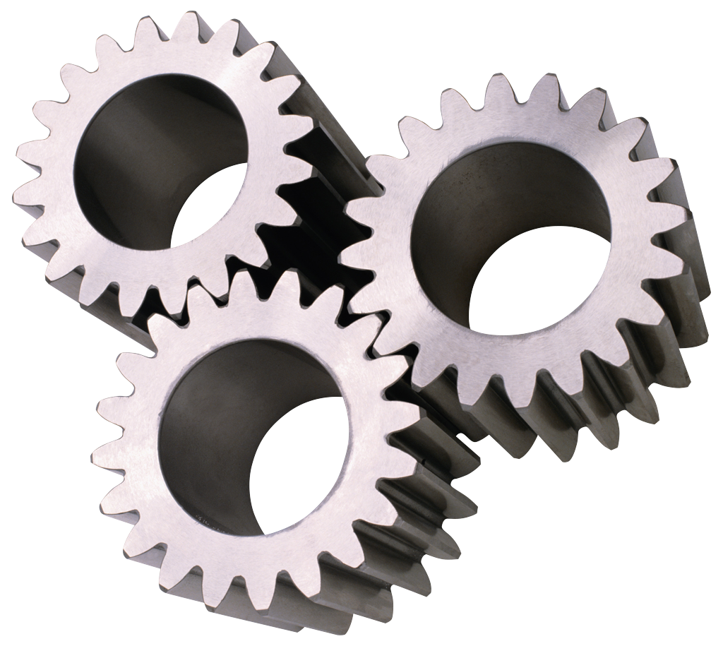
Issues & Improvements
Database
Machine learning
Azure – Running out of credit
Data rate – Too slow
Frequency – US & EU
Notes:
Michael & Remi

Slide 25

Conclusion
What have we learnt?
Power BI
Jira
Azure
Arduino
Machine Learning
Etc.
Notes:
All

Slide 26


Q&A
Notes:
All

